Slide 1
NTP Time for iThingies
A Network Time Protocol
app. for iPhone and iPad
Presented to TTSO8
on 2456765.63542
by Chris Douglass

Slide 2
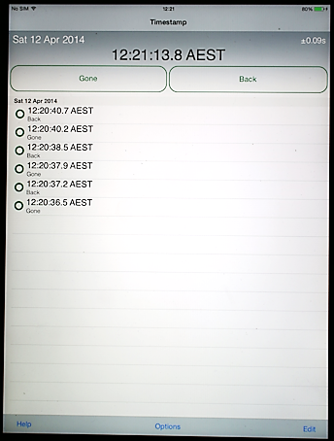
Emerald Timestamp by Emerald Sequoia LLC
Current
Day / Date
Accuracy
Action Buttons
Running
Clock
Recorded Times
Task Bar

Slide 3
Accuracy
The iPhone's or iPad’s internal clock can be somewhat unreliable.
When Emerald Timestamp starts (and every time it is awakened after the device has been locked)
it uses NTP to synchronize its own clock with the international standard atomic clocks.
This process requires network access and can take several seconds.
Until it is done the accuracy of event timing is somewhat uncertain.
During that uncertain time, Emerald Timestamp's big button is yellow.
When the sync is complete, the button turns green and event timing is very accurate.
At the top right of the main screen is an indicator of the current accuracy.
The accuracy of synchronized events is primarily constrained by the length of time it takes
for a round trip from the device to the NTP server and back; server times are usually
much more accurate than that round-trip time. Emerald Timestamp reports the
accuracy based on that round-trip time and includes an estimate of the server error.
A synchronization is considered "green" if its reported accuracy is less than 0.40 seconds.

Slide 4
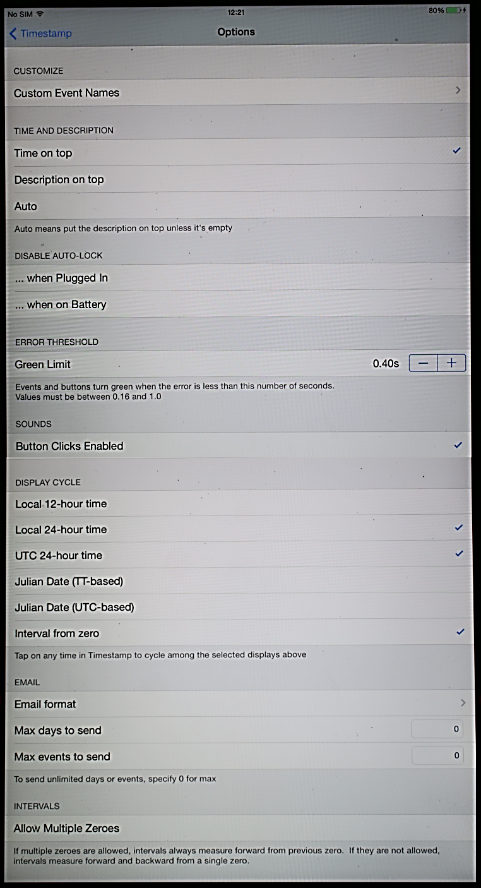
Timestamp
Options

Slide 5
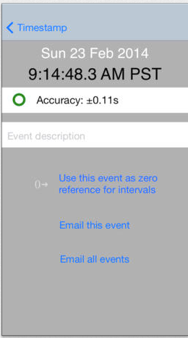
Email
events

Slide 6
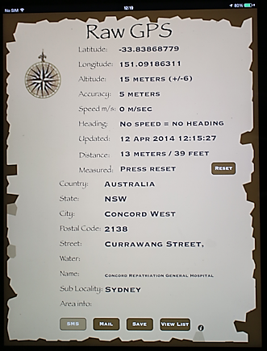
Raw GPS
by Gosta Svensson

Slide 7
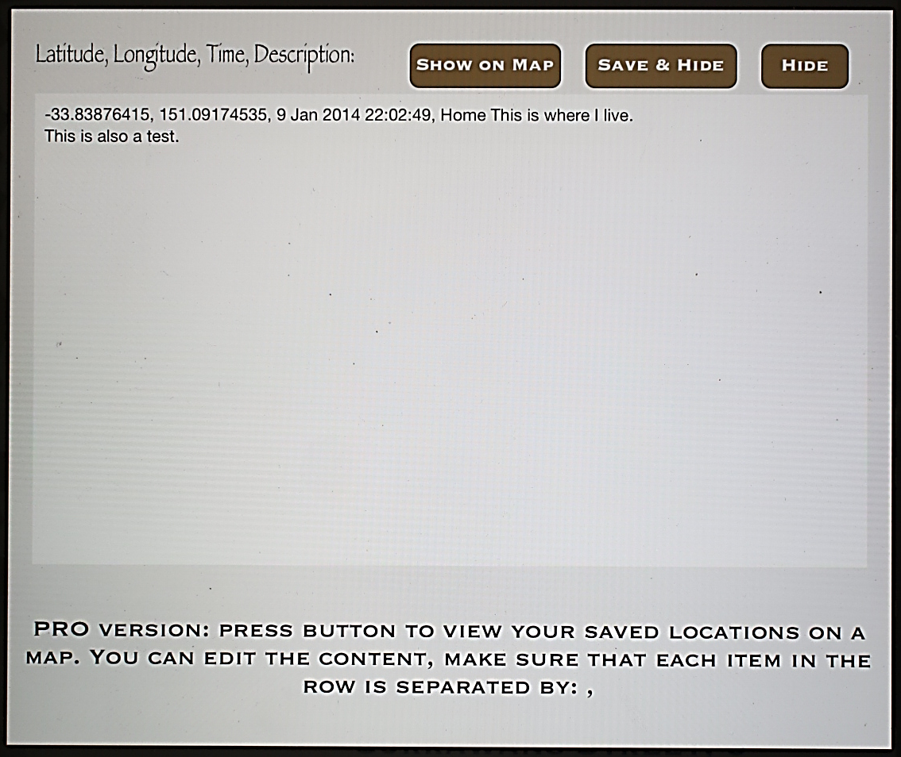
Location
Details

Slide 8
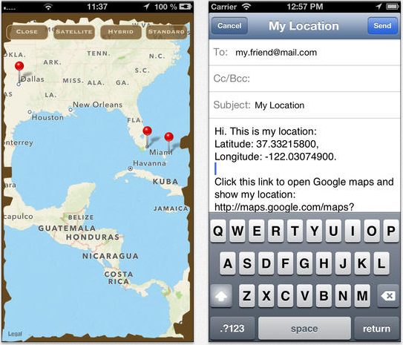
Map, email
and SMS

Slide 9
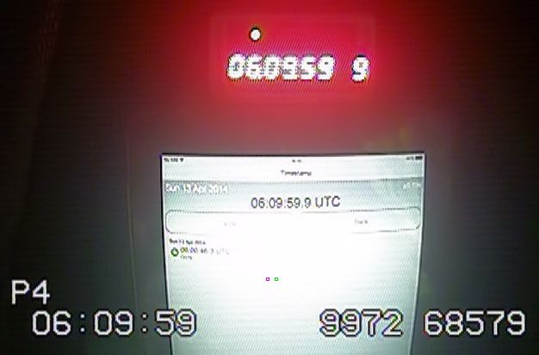
Timing accuracy
Accuracy [in this case] = 0.08sec
Must be added to your PE when reporting these events
GPS-ABC
Timestamp
IOTA-VTI

Slide 10
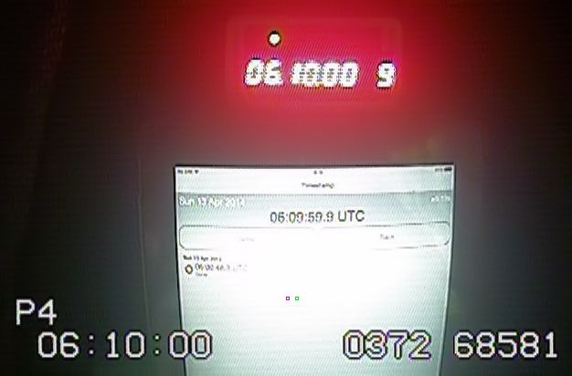
Timing accuracy
Accuracy [in this case] = 0.08sec
Must be added to your PE when reporting these events

Slide 11
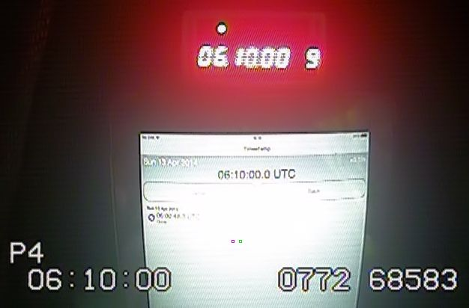
Timing accuracy
Accuracy [in this case] = 0.08sec
Must be added to your PE when reporting these events

